Slide 1
Final Thesis
Suitability of Modern Wi-Fi for Wireless Infield-Communication
Karl Lautenschläger
Notes:
My Name is
I'm studying Information System Engineering in my kind of Masters at the TU Dresden
Start final thesis in November
<number>
2/8/23

Slide 2
Agenda
Motivation Final Thesis
Physical Layer Technologies
Field Measurements
Simulation Experiments

Slide 3
Modern Wi-Fi
 | IEEE 802.11ac (Wi-Fi 5) | IEEE 802.11ax (Wi-Fi 6)
Spectrum | 5 GHz | 2.4 GHz, 5 GHz
Bandwidth | Up to 160 MHz | Up to 40 Mhz (2.4 GHz), 160 Mhz at 5 GHz
OFDM Guard Interval | 0.4 or 0.8 μs | 0.8, 1.6 or 3.2 μs
Maximal Data Rate | 6.9 Gbit/s | 9.6 Gbit/s
Max Modulation Coding Scheme | 256-QAM | 1024-QAM
Multi-User Technology | MU-MIMO | MU-MIMO, OFDMA
Multi-User Transmission Direction | Downlink | Downlink und Uplink
K. Lautenschlaeger, Suitability of Modern Wi-Fi for Wireless Infield-Communication
<number>
Notes:
Of course better Data Rate
Multi user? Stadium
Because when to many people want to
But Amendments for improving outdoor communication
But indoor and outdoor range in the agriculture domain is unknown
<number>

Slide 4
Physical Layer Technologies

Slide 5
Physical Layer Technologies
OFDM Guard Interval
Low density parity check
Dual Carrier Modulation
Extended Range Mode
Multiple Input Multiple Output
Space-Time-Block-Codes
Bandwidth
...
Notes:
Modulation Coding Scheme
New Error correction codes
Transmission power
Any questions so far?
What is possible?
What do we need? How bad are shadowing effect multipath effects?
Dave Smart getting in touch with the chips companies?

Slide 6
Range
Throughput
Robustness
Notes:
Modulation Coding Scheme
New Error correction codes
Transmission power
Any questions so far?
What is possible?
What do we need? How bad are shadowing effect multipath effects?
Dave Smart getting in touch with the chips companies?

Slide 7
Modern Wi-Fi
Wi-Fi 6
(802.11ax):
4 MIMO Streams
2.4 GHz and 5 GHz
STBC
DCM
Extended Range Mode
LDPC
Bandwidth(20-160 MHz)
802.11bd:
1 Stream
5.9 Ghz
DCM
Extended Range
LDPC
Bandwidth(10-20)

Slide 8
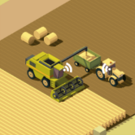
Simulation
Harvest Platooning Service
K. Lautenschlaeger, Suitability of IEEE 802.11ax \ IEEE 802.11ac for Wireless Infield-Communication
<number>
Notes:
Physical Layer amendment of Wifi 6
Longer Preamble for extended range
Next transporting machine waiting in line
Simulate such a system
3-5 Harvest Platoons on a field?
<number>

Slide 9
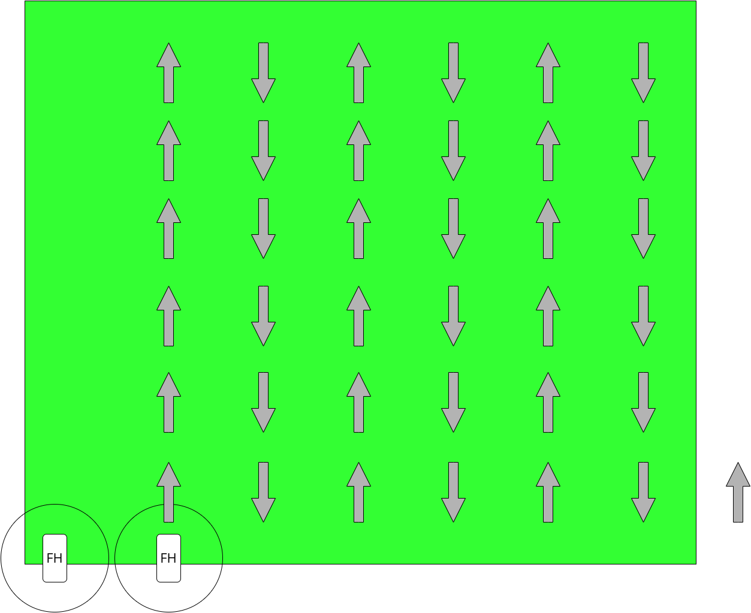
Simulation
Harvest Platooning Service

Slide 10
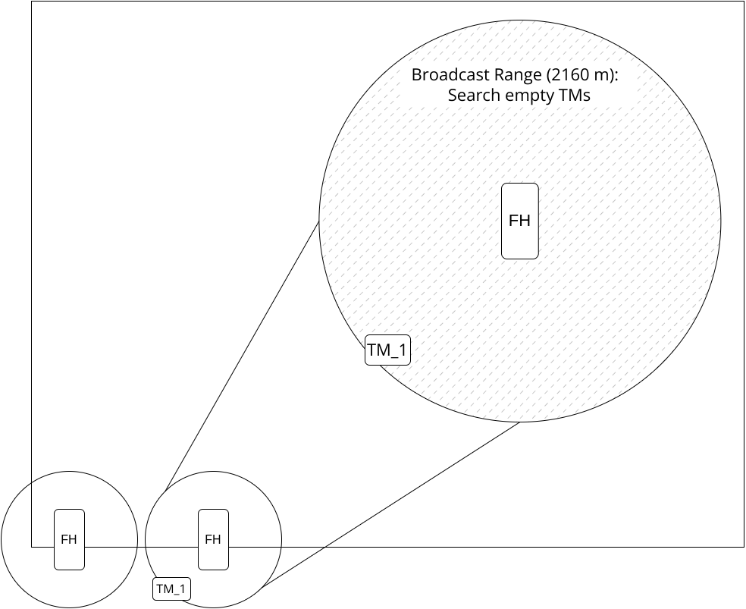
Simulation
Harvest Platooning Service

Slide 11
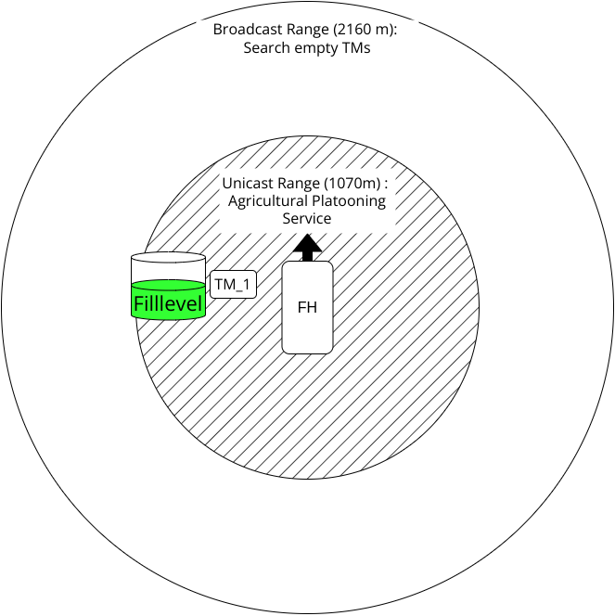
Simulation
Harvest Platooning Service

Slide 12
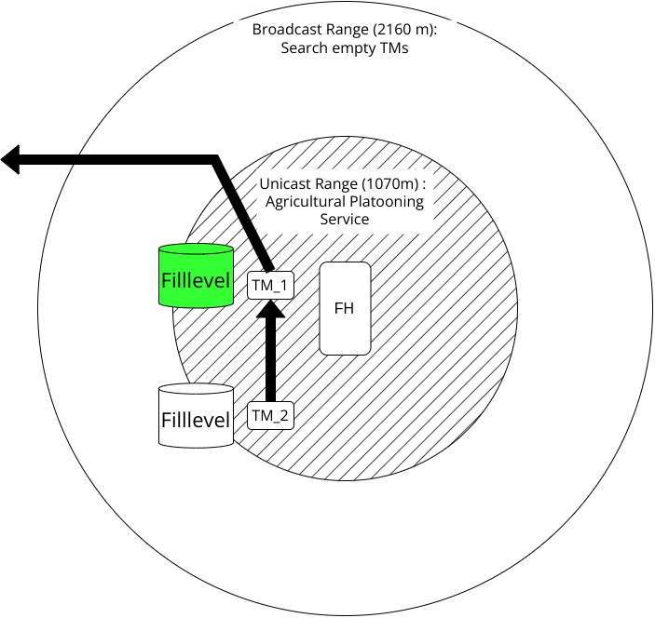
Simulation
Harvest Platooning Service

Slide 13
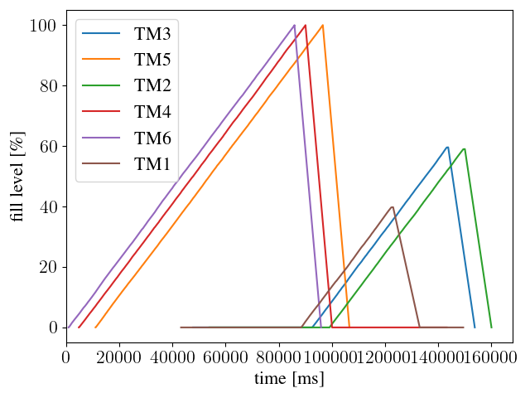
Simulation
Harvest Platooning Service

Slide 14
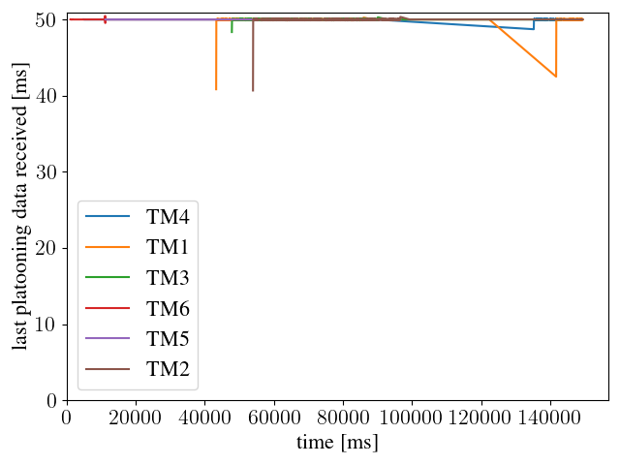
Simulation
Harvest Platooning Service

Slide 15
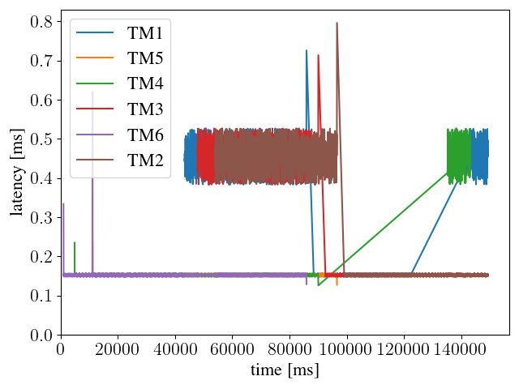
Simulation
Harvest Platooning Service

Slide 16

Simulation
Agricultural Platooning Service in Leader-Follower-Scenario
Follower_2
Follower_1
Leader
K. Lautenschlaeger, Suitability of IEEE 802.11ax \ IEEE 802.11ac for Wireless Infield-Communication
<number>
Notes:
<number>

Slide 17
Field Measurements

Slide 18
Summary
Analyzing Telemetry data of Use Cases
required latency
required data Rate
required communication distance
Field measurements
communication range
received signal strength in agricultural scenarios
Latency
Simulation
Leader-Follower-Scenario
Harvest-Platoon-Scenario
K. Lautenschlaeger, Suitability of IEEE 802.11ax \ IEEE 802.11ac for Wireless Infield-Communication
<number>
Notes:
Recall interest in the topic Advice, recommendations,
Cooperate work together
Frame of a final thesis, support the group

Slide 19
Thanks!
Notes:
<number>
2/8/23

